Slide 1
Side Effect Prediction with GNN
Vijeta Deshpande
November 18, 2021

Slide 2
Content
Background
Data
Components
Inter-relations
Problem
Objective
Objective function
Plan
Experiments

Slide 3
Background
Polypharmacy
Complex cases
Parallel conditions – comorbidities
Conditions such as HIV or TB
MEPS data: prescription expenses are high
Understanding different moving parts
Micro view of biology
Composition of the drug
Mutual relationship between drug and biology

Slide 4
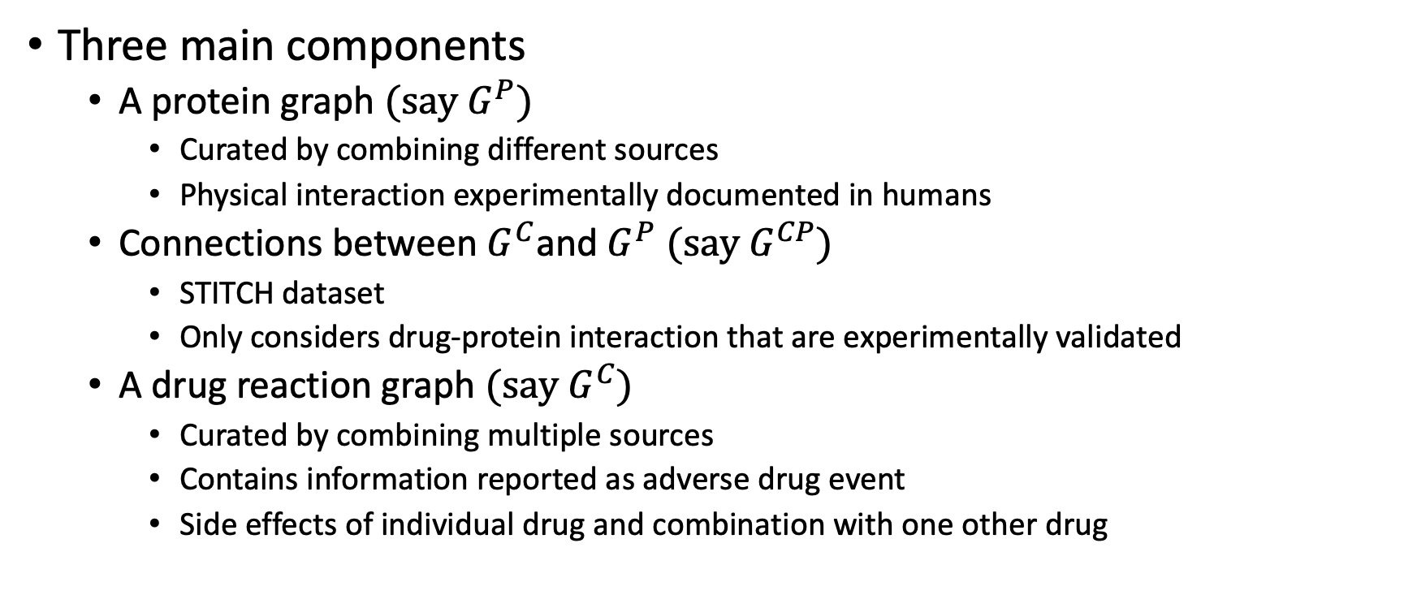
Data
Three main components
A protein graph $(say G^{P})$
Curated by combining different sources
Physical interaction experimentally documented in humans
Connections between $G^{C}$and $G^{P}$ $(say G^{CP})$
STITCH dataset
Only considers drug-protein interaction that are experimentally validated
A drug reaction graph $(say G^{C})$
Curated by combining multiple sources
Contains information reported as adverse drug event
Side effects of individual drug and combination with one other drug

Slide 5
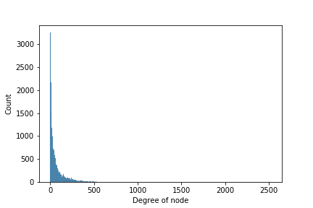
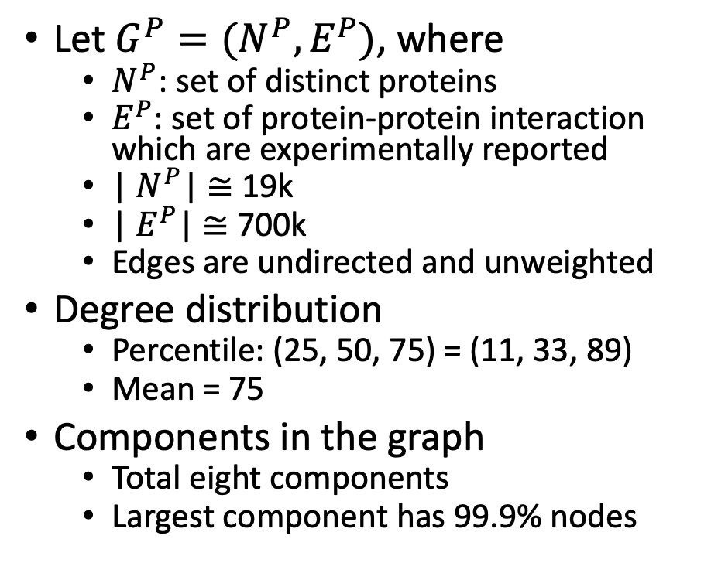
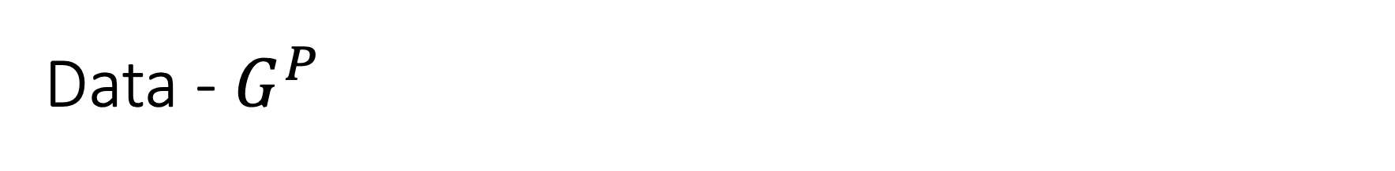
Data - $G^{P}$
Let $G^{P}=(N^{P}, E^{P})$, where
$N^{P}$: set of distinct proteins
$E^{P}$: set of protein-protein interaction which are experimentally reported
| $N^{P}$| $≅$ 19k
| $E^{P}$| $≅$ 700k
Edges are undirected and unweighted
Degree distribution
Percentile: (25, 50, 75) = (11, 33, 89)
Mean = 75
Components in the graph
Total eight components
Largest component has 99.9% nodes

Slide 6
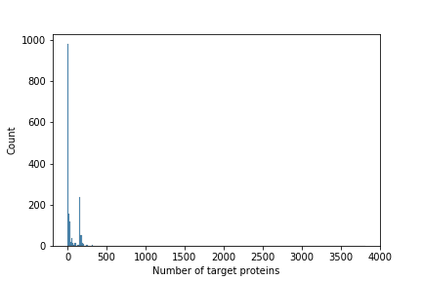
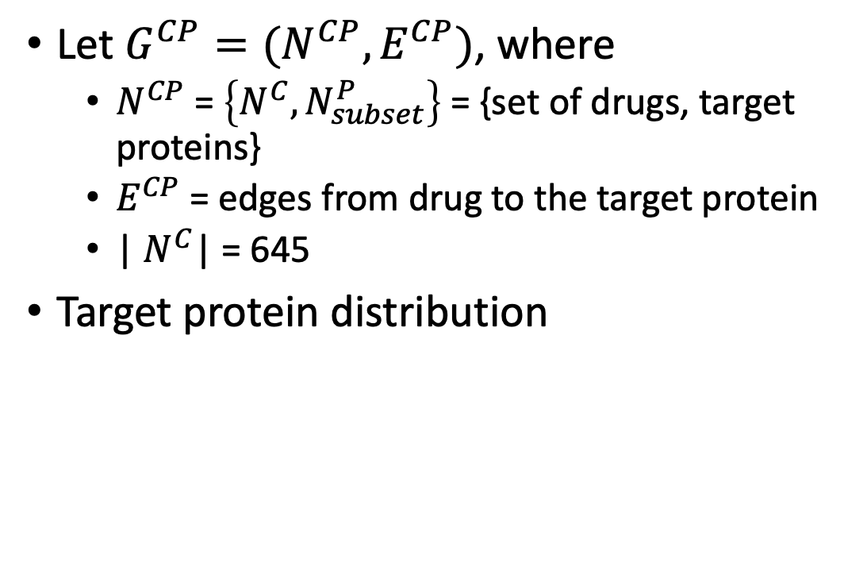
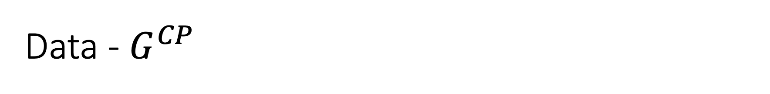


Data - $G^{CP}$
$$N^{C}$$
$$N_{subset}^{P}$$
Let $G^{CP}=(N^{CP}, E^{CP})$, where
$N^{CP}$ = $\left\{N^{C}, N_{subset}^{P}\right\}$ = {set of drugs, target proteins}
$E^{CP}$ = edges from drug to the target protein
| $N^{C}$| = 645
Target protein distribution
 | 25th Perc. | 50th | 75th | Mean
Target proteins | 2 | 9 | 79 | 74
Overlap of target proteins for a pair of drugs | 0 | 0 | 0.6% | 9.8%

Slide 7
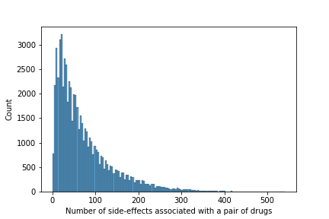
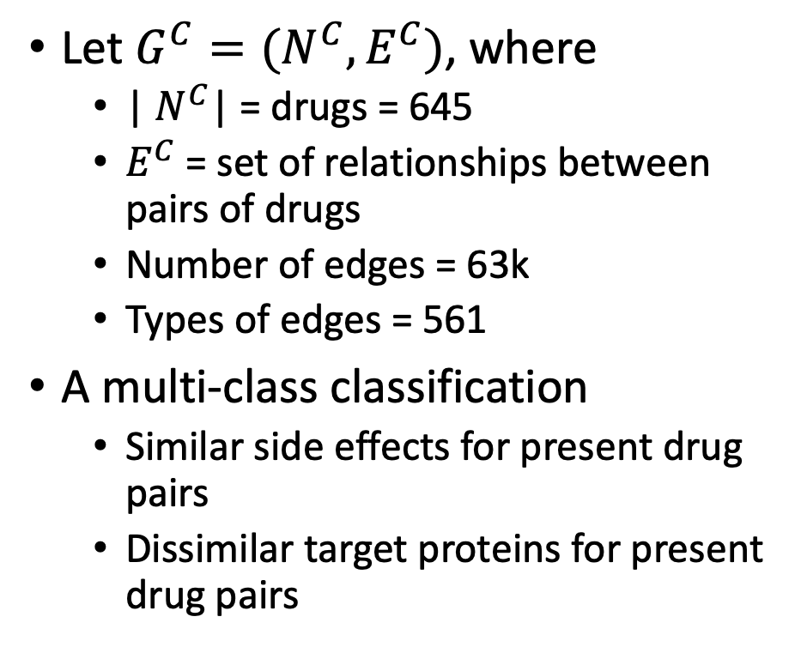
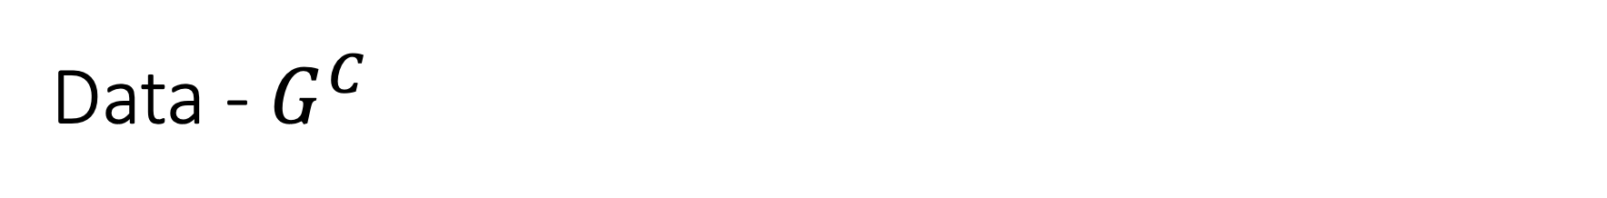
Data - $G^{C}$
Let $G^{C}=(N^{C}, E^{C})$, where
| $N^{C}$| = drugs = 645
$E^{C}$ = set of relationships between pairs of drugs
Number of edges = 63k
Types of edges = 561
A multi-class classification
Similar side effects for present drug pairs
Dissimilar target proteins for present drug pairs

Slide 8
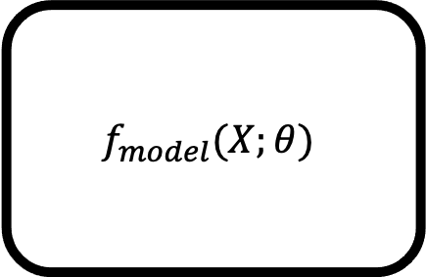
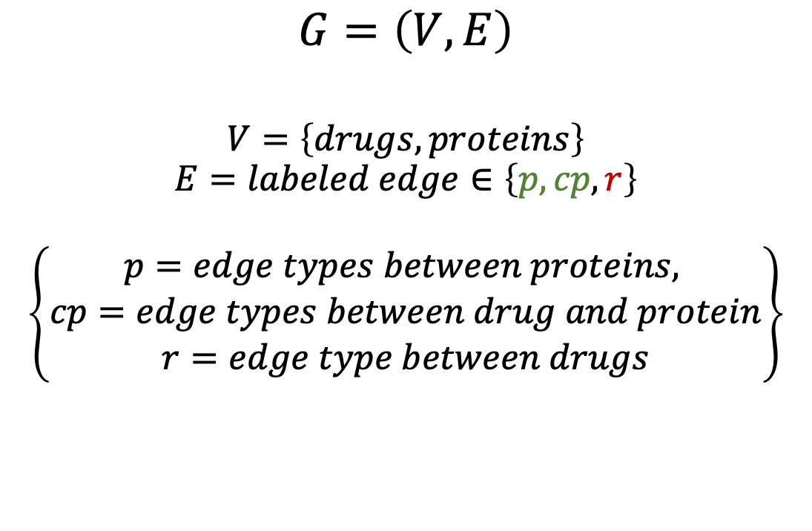
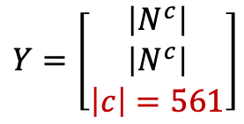
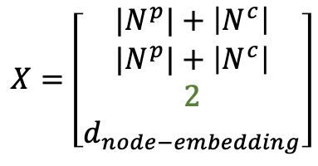
Problem - objective
$$X=\left[\begin{matrix}|N^{p}|+\left|N^{c}\right| \\ |N^{p}|+\left|N^{c}\right| \\ \begin{matrix}2 \\ d_{node−embedding}\end{matrix}\end{matrix}\right]$$
$$G=\left(V, E\right)$$
$$V=\left\{drugs, proteins\right\}$$
$$E=labeled edge∈\left\{p, cp, r\right\}$$
$$\left\{\begin{aligned}p=edge types between proteins, \\ cp=edge types between drug and protein \\ r=edge type between drugs\end{aligned}\right\}$$
$$f_{model}(X;θ)$$
$$Y=\left[\begin{matrix}\left|N^{c}\right| \\ \left|N^{c}\right| \\ \left|c\right|=561\end{matrix}\right]$$

Slide 9

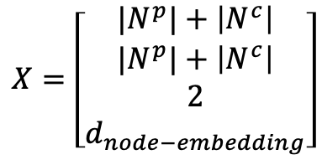

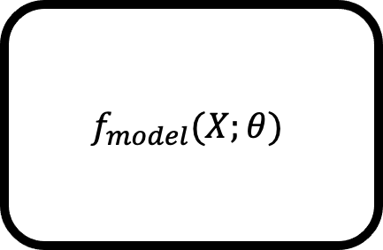
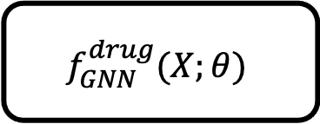
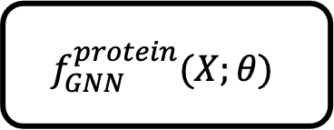

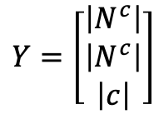

Problem – objective in GNN perspective
$$X=\left[\begin{matrix}|N^{p}|+\left|N^{c}\right| \\ |N^{p}|+\left|N^{c}\right| \\ \begin{matrix}2 \\ d_{node−embedding}\end{matrix}\end{matrix}\right]$$
$$X$$
$$f_{model}$$
$$f_{GNN}^{protein}(X;θ)$$
$$f_{GNN}^{drug}(X;θ)$$
$$f_{model}(X;θ)$$
$$f_{NN}^{}(X;θ)$$
$$Y=\left[\begin{matrix}\left|N^{c}\right| \\ \left|N^{c}\right| \\ \left|c\right|\end{matrix}\right]$$
$$Y$$

Slide 10




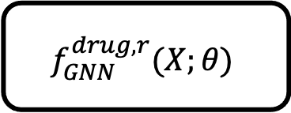

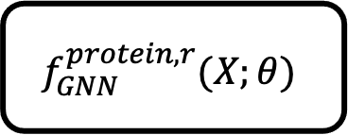


Problem – objective in GNN perspective
$$data=X, query=(c_{i},c_{j})$$
$$X=\left[\begin{matrix}|N^{p}|+\left|N^{c}\right| \\ |N^{p}|+\left|N^{c}\right| \\ \begin{matrix}2 \\ d_{node−embedding}\end{matrix}\end{matrix}\right]$$
$$f_{model}^{r}$$
$$f_{GNN}^{protein,r}(X;θ)$$
$$f_{GNN}^{drug,r}(X;θ)$$
$$f_{model}(X;θ)$$
$$agg$$
$$z_{c_{i}}$$
$$z_{c_{j}}$$
$$f_{NN}^{r}(X;θ)$$
$$Y=\left[\begin{matrix}\left|N^{c}\right| \\ \left|N^{c}\right| \\ \left|c\right|\end{matrix}\right]$$
$$Y= \left[\begin{matrix}1 & 1 & 1 (out of 561)\end{matrix}\right]$$

Slide 11
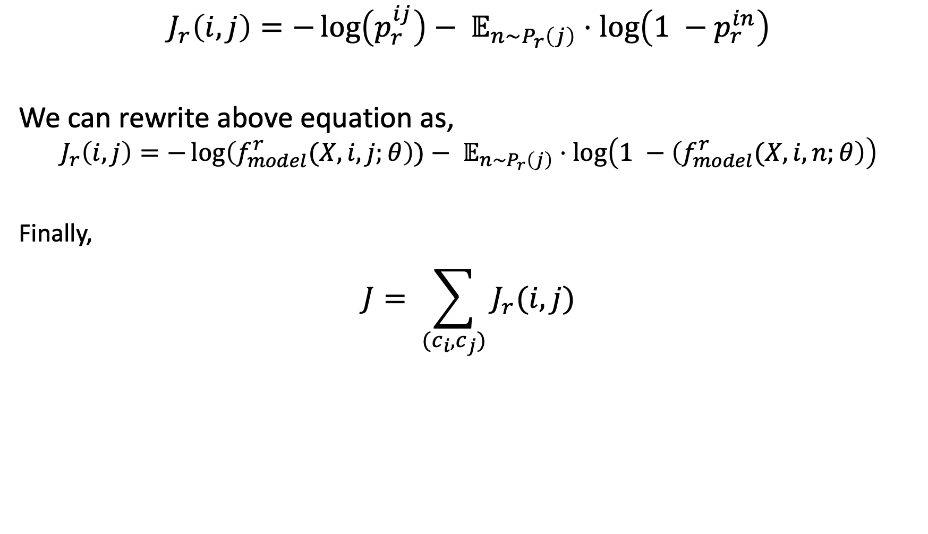
Problem – objective function
$$J_{r}\left(i,j\right)=−\log\left(p_{r}^{ij}\right)− 𝔼_{n\sim P_{r}\left(j\right)}⋅\log\left(1 −p_{r}^{in}\right)$$
We can rewrite above equation as,
$$J_{r}\left(i,j\right)=−\log\left(f_{model}^{r}(X, i,j;θ\right))− 𝔼_{n\sim P_{r}\left(j\right)}⋅\log\left(1 −\left(f_{model}^{r}(X, i,n;θ\right)\right)$$
Finally,
$$J= \sum_{(c_{i}, c_{j})}{J_{r}(i,j)}$$

Slide 12
Plan – model development and experiments
Formulate as a supervised task instead of two-step approach
Simplify the problem
Share weights across the different types of drug-drug relations
Share weights for protein and drug-protein graph networks
Initial embeddings
We know adverse event type for every drug
MedSpacy
BioBERT
Preprocessing needs be done for protein embeddings
Hyper-parameter tuning
GNN depth
Learning rate
Dropout
Aggregators

Slide 14












Set of side-effects
for every drug
Initial node embeddings, e
(unsupervised GraphSAGE)
Models to be trained
$S, G^{CC}$
$$f^{SciBERT}(⋅)$$
$$f^{GNN, CC}(⋅)$$
$$e^{c}$$
Available data
$$e^{p}$$
Inductive node
representations
$G^{PP}$
$$f^{GNN,PP}(⋅)$$
Protein-to-protein
graph
Side-effect
$$c_{i},c_{j}$$
$$f^{GNN,CP}(⋅)$$
$$f_{1}^{NN}(⋅)$$
$$z_{i},z_{j}$$
$$f_{2}^{NN}(⋅)$$
No side-effect
Set of queries
(Q)
Node embeddings, z
(supervised GraphSAGE)
Target for supervised
learning (r)

